Slide 1
Their Exits and Their Entrances
Actors in the .NET Environment

Slide 2
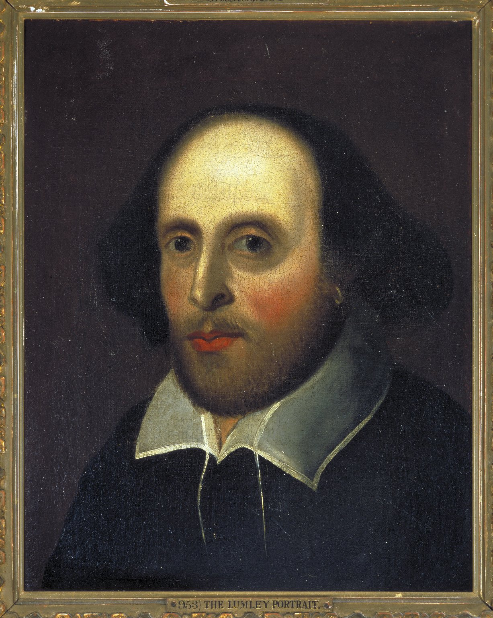
All the world's a stage, And all the men and women merely players; They have their exits and their entrances, And one man in his time plays many parts…
William Shakespeare, As You Like It, Act II, Scene VII

Slide 3
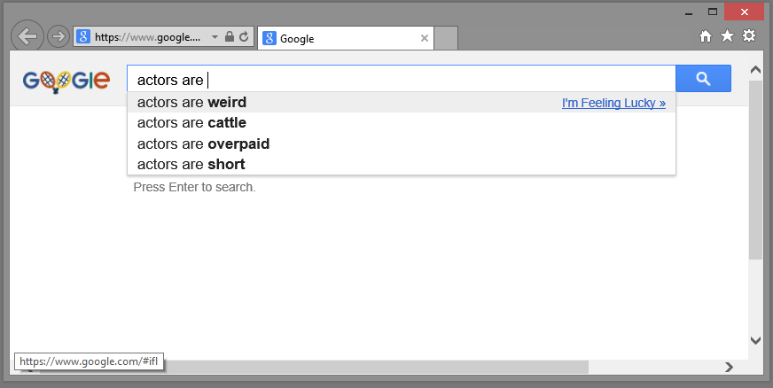
Actors are…

Slide 4
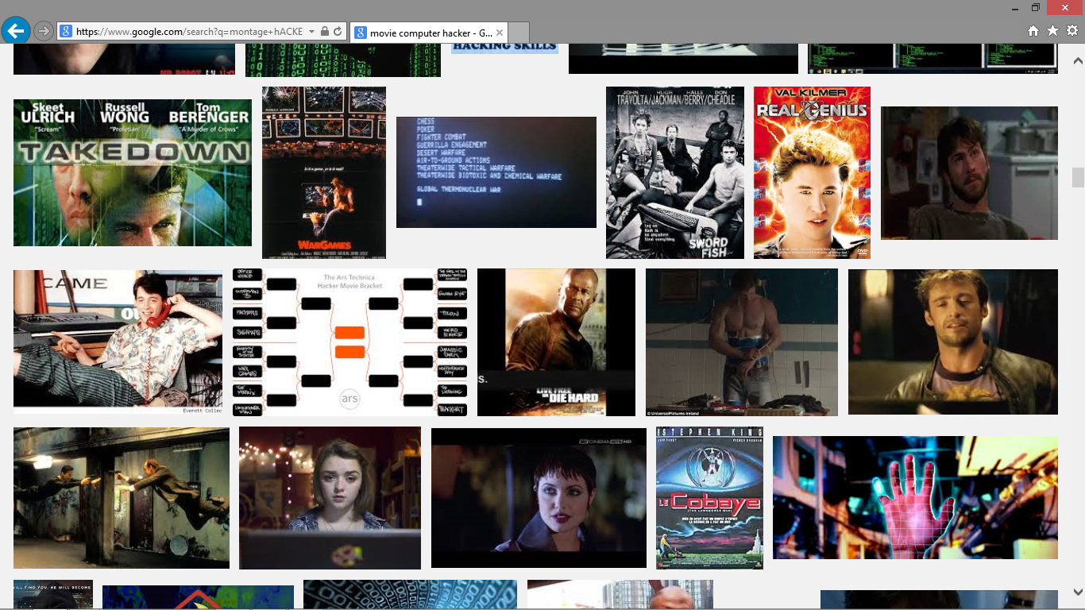
Actors and… Software?

Slide 5
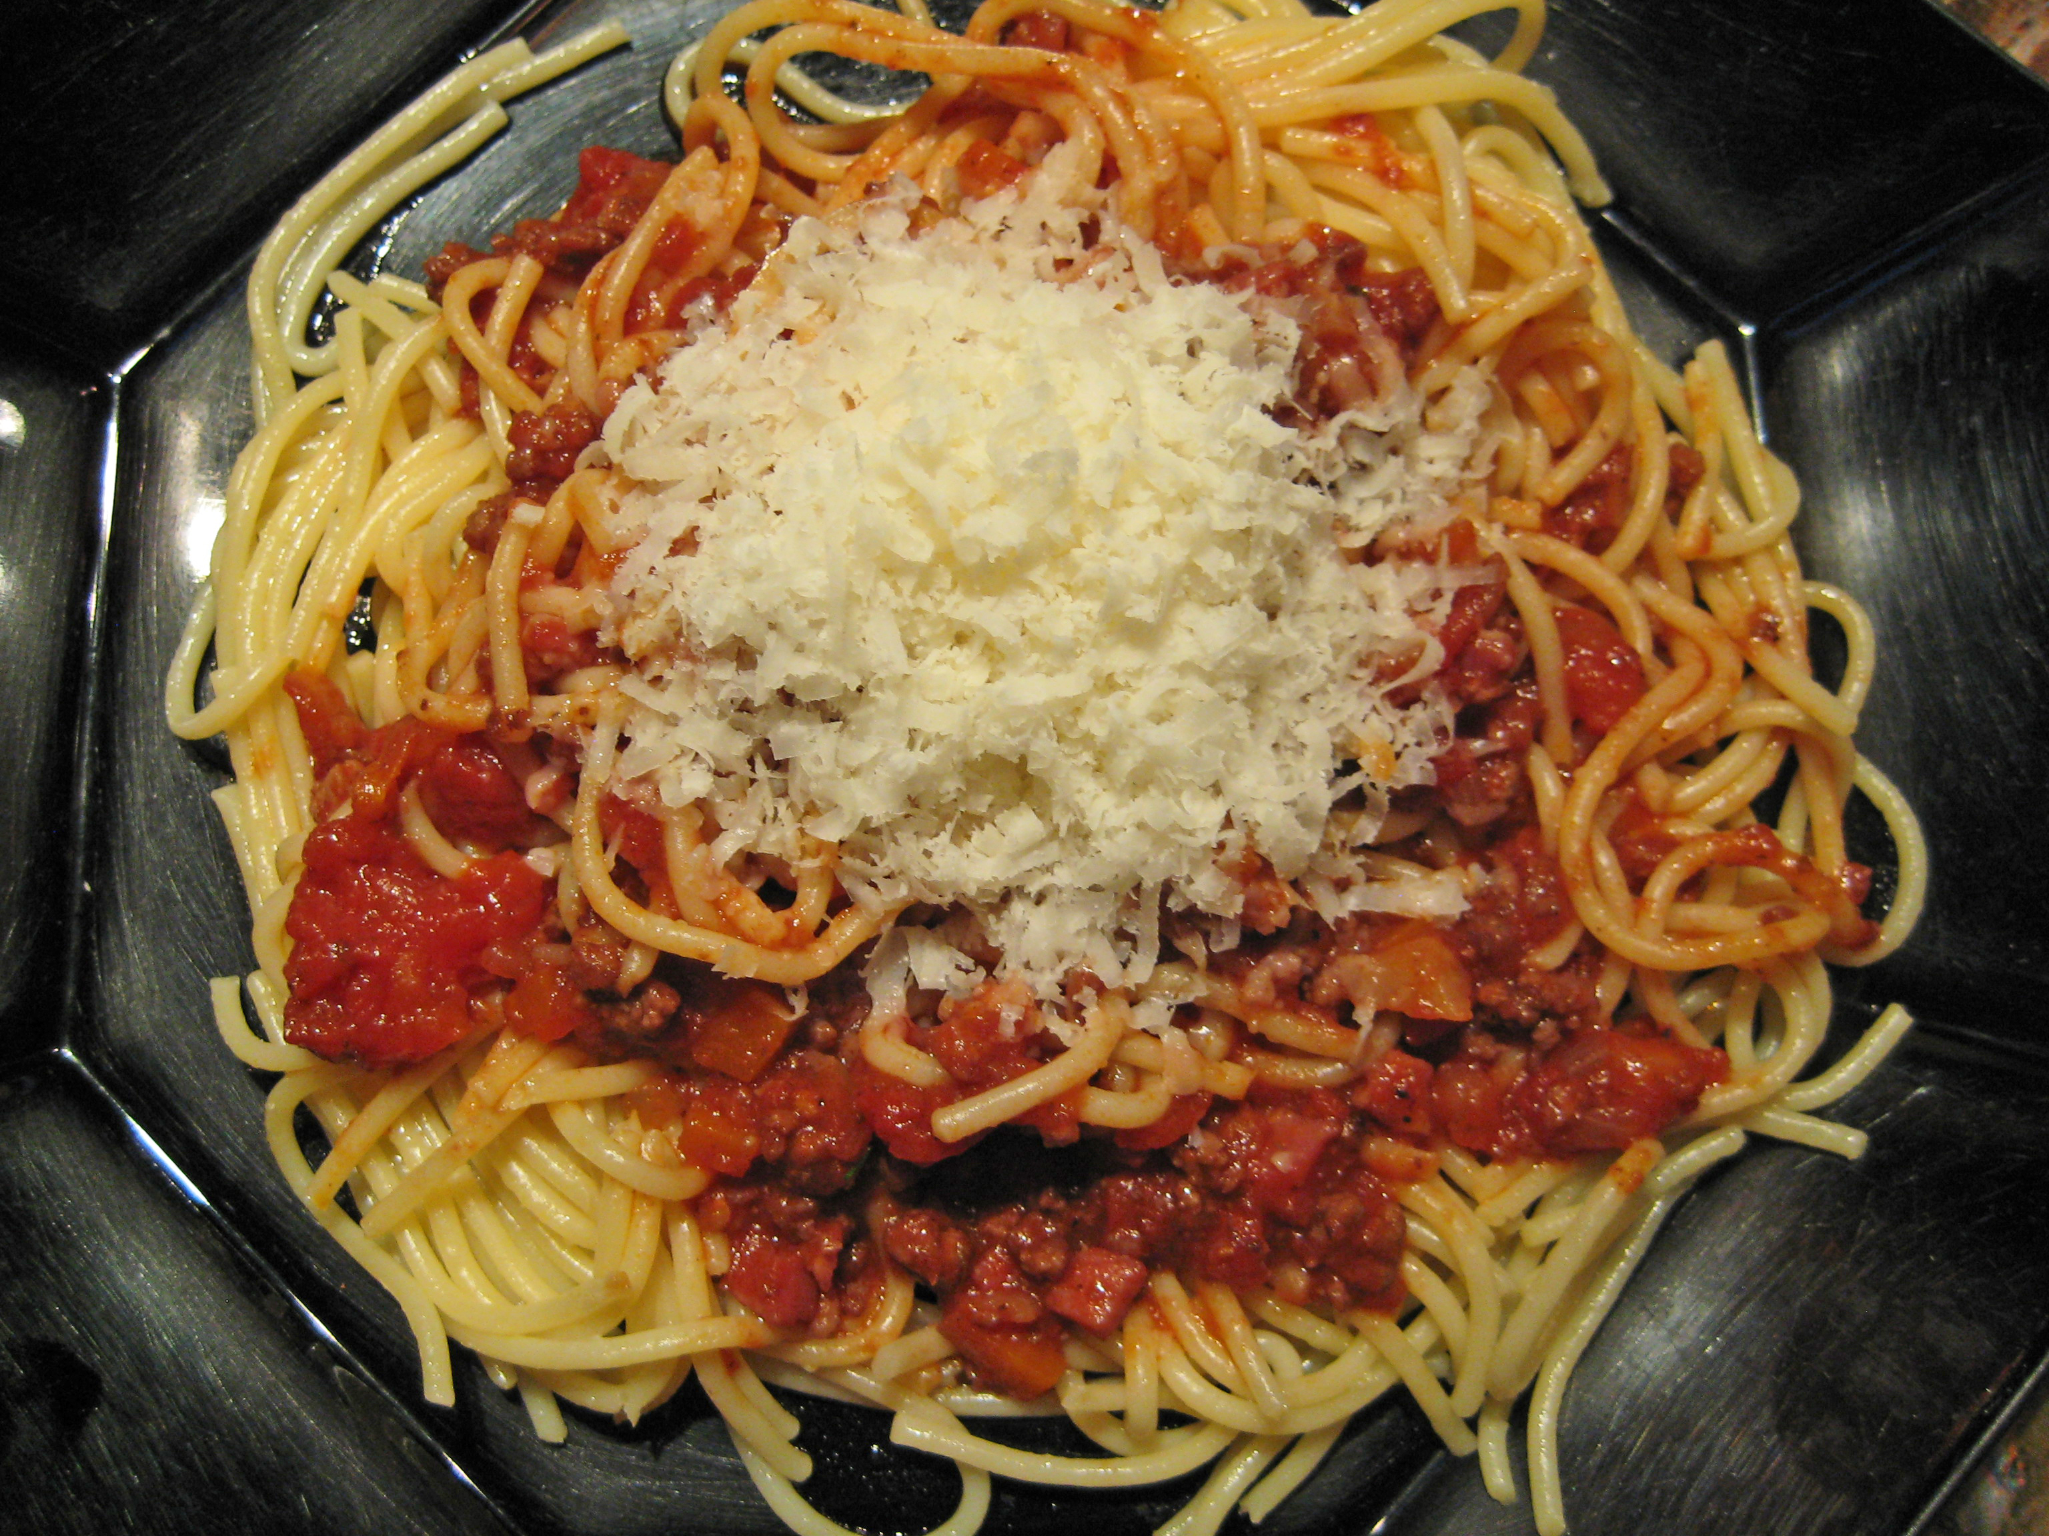
goto step_spag; step_spag:

Slide 6
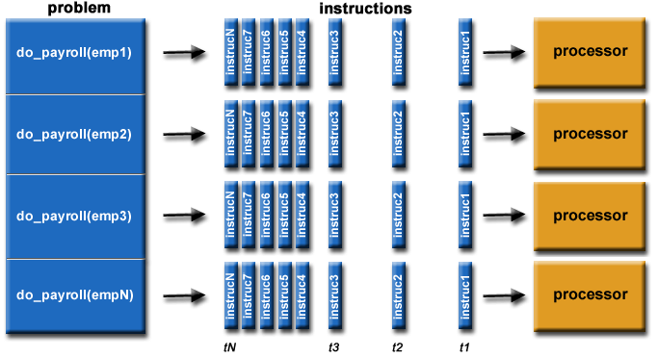
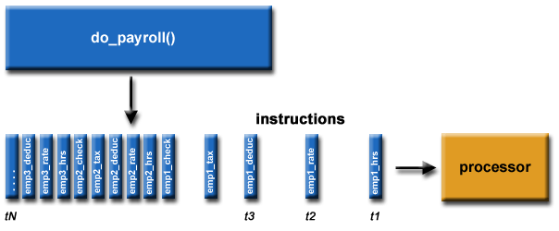
Parallel Programming
From this…
…to this:

Slide 7
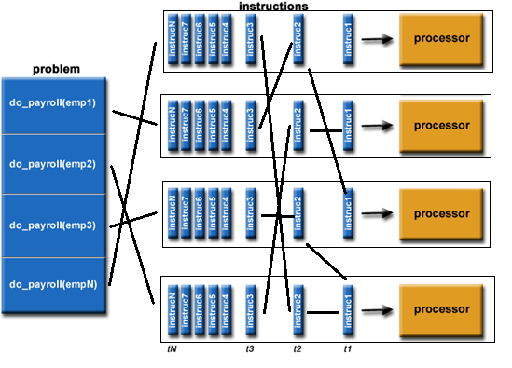
Actor Programming
…to this:

Slide 8
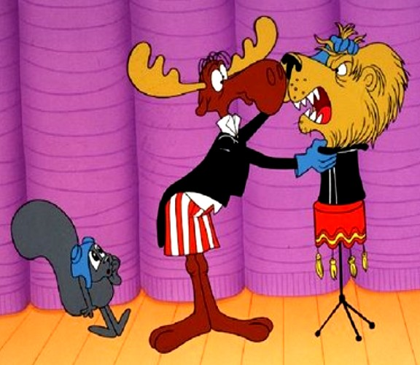
It didn’t work

Slide 9
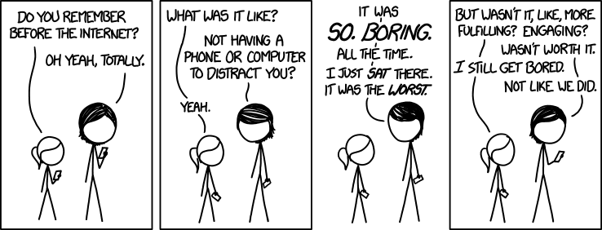
The Internet
<img src="//imgs.xkcd.com/comics/before_the_internet.png" title="We watched DAYTIME TV. Do you realize how soul-crushing it was? I&#39;d rather eat an iPad than go back to watching daytime TV." alt="Before the Internet" />

Slide 10

Microsoft .NET and Actors
…it’s complicated.

Slide 11
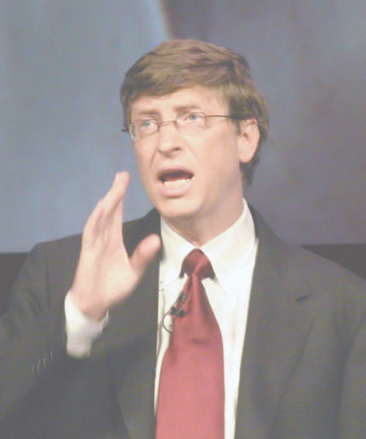
The Internet is a passing fad.
Bill Gates, 1993
No, he didn’t say this. He’s not stupid.
It certainly felt that way at the time.

Slide 12
Microsoft Azure Reliable Actors
Part of Azure Service Fabric
Always-on Services based upon ‘microservices’
Many independent units of state and logic
Single-threaded objects that will still scale
You don’t want to manage their granularity or concurrency
You don’t want to manage their messages

Slide 13
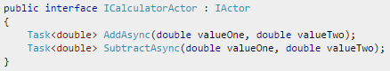

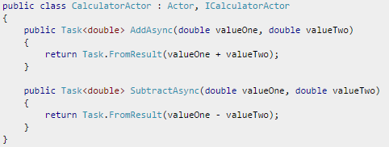
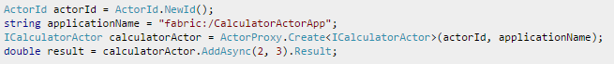
Reliable Actor Interface and Proxy

Slide 14
Akka and the Reactive Manifesto
Reactive Systems are:
Responsive: The system responds in a timely manner if at all possible.
Resilient: The system stays responsive in the face of failure.
Elastic: The system stays responsive under varying workload.
Message Driven: The system uses asynchronous messages to establish a boundary between components.

Slide 15

Akka.NET – ACT ALL THE THINGS

Slide 16
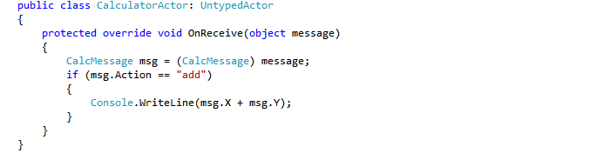
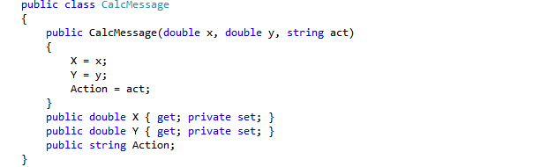

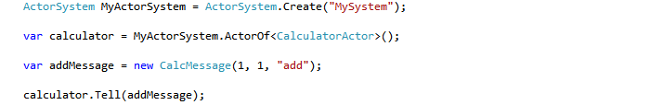
UntypedActor, message, and IActorRef

Slide 17
Choices
Reliable Actors
Akka.NET
Service Fabric
Azure only
Orleans & Halo
Still pre-release
Child-proofed
ActorSystem
Wherever .NET runs
Open Source
Existing Akka base
No safety net

Slide 18

Actor Example
Hot lines under a rain of drum Cigarette props in action
Dialogue dub, now here’s the rub She's acting her reaction
-- Bauhaus, “She’s In Parties” (1983)

Slide 19
Thanks For Your Interest
All material for this talk will be available at https://carteritrellis.github.io/CodeCamp2015
If you found this at all interesting, come talk to me – we’re hiring.

Slide 20

Carter Wickstrom
Software Engineer
https://www.linkedin.com/in/carterwickstrom
https://twitter.com/carterwickstrom

